Slide 1
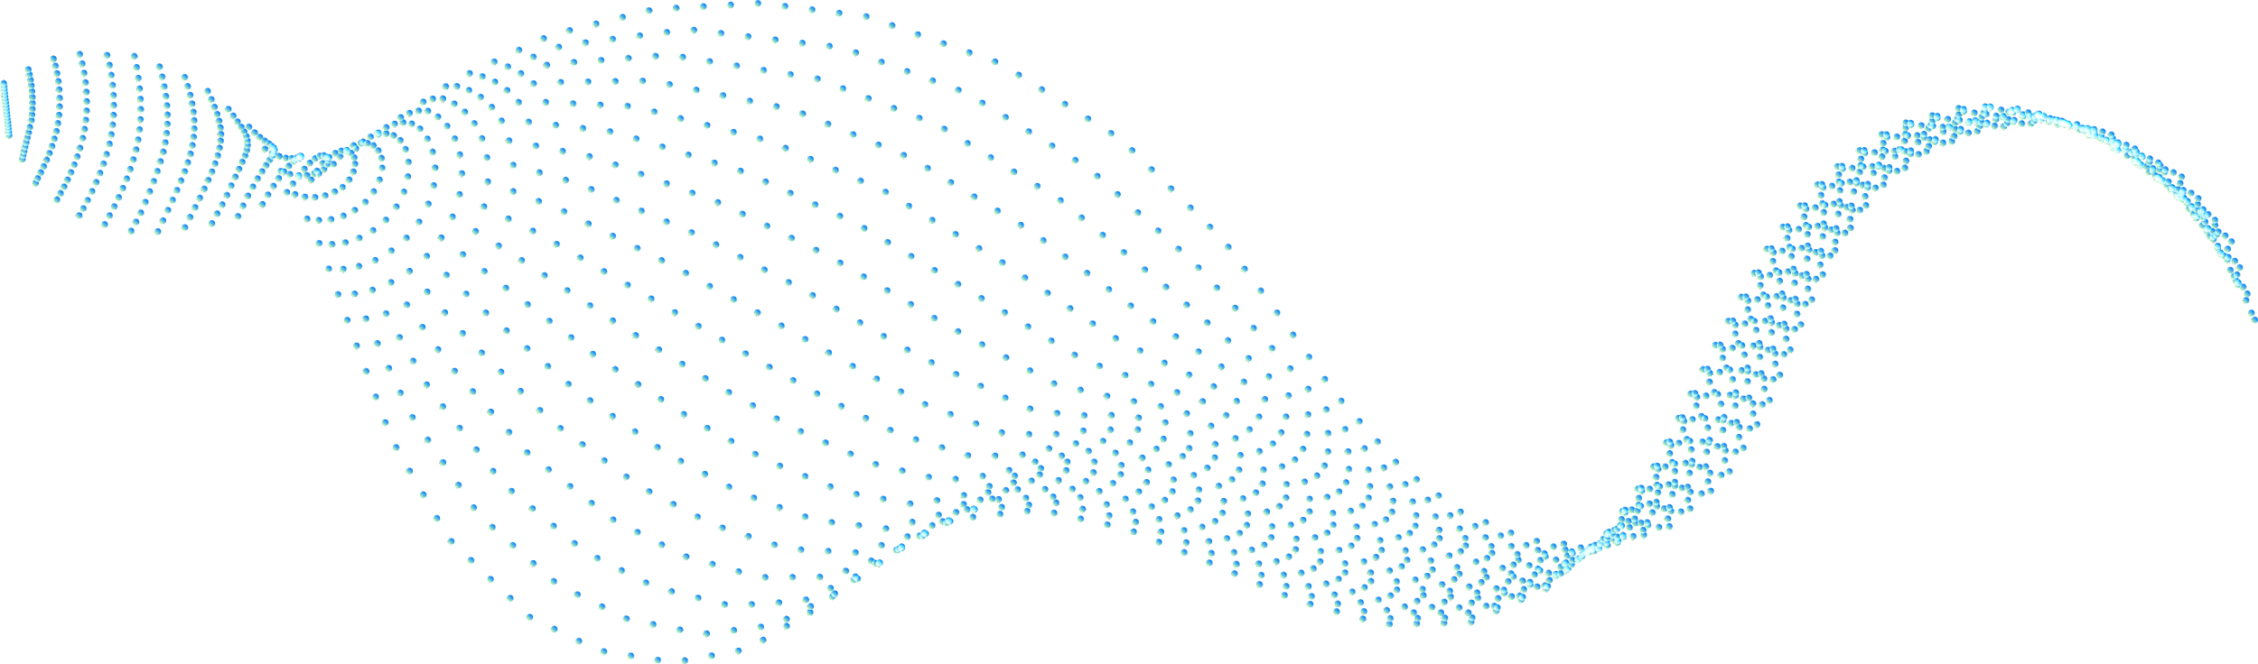
AI-BOT
(AID IN WRITING AND UNDERSTANDING COMPOSITIONS)
This article presents a solution for visually impaired students who face difficulties in studying text and electronic documents. An experimental prototype is developed using NLP techniques to assist the blind community with information access. The chatbot employs techniques such as automatic index generation, paraphrasing, summarizing, passage retrieval, and query rewriting. The chatbot uses tools such as Torch, Sentence piece, Newspaper3k, and the Natural Language Toolkit to achieve its goals.
The proposed software aims to reduce the time required for writing and understanding compositions, making information access easier for visually impaired students and other people.
Team Members :
Dhyan 20BCE7648
Jeevantika Gurung 20BCR7087
Shreyas M B 20BCR7106

Slide 2
Abstract
This article presents a solution for visually impaired students who face difficulties in studying text and electronic documents. An experimental prototype is developed using NLP techniques to assist the blind community with information access. The chatbot employs techniques such as automatic index generation, paraphrasing, summarizing, passage retrieval, and query rewriting. The chatbot uses tools such as Torch, Sentence piece, Newspaper3k, and the Natural Language Toolkit to achieve its goals.
The proposed software aims to reduce the time required for writing and understanding compositions, making information access easier for visually impaired students and other people.
Automatically generate useful information on any topic with a few clicks and words.
Developed to make life easier for the blind community.
Powered by advanced NLP techniques and WordNet-based query rewriting, so you get relevant results in no time.
Get access to the right info with ease, as it is read aloud to you. No need for complicated navigation anymore.

Slide 3
Need of proposed Work
This article presents a solution for visually impaired students who face difficulties in studying text and electronic documents. An experimental prototype is developed using NLP techniques to assist the blind community with information access. The chatbot employs techniques such as automatic index generation, paraphrasing, summarizing, passage retrieval, and query rewriting. The chatbot uses tools such as Torch, Sentence piece, Newspaper3k, and the Natural Language Toolkit to achieve its goals.
The proposed software aims to reduce the time required for writing and understanding compositions, making information access easier for visually impaired students and other people.
Automatically generate useful information on any topic with a few clicks and words.
Developed to make life easier for the blind community.
Powered by advanced NLP techniques and WordNet-based query rewriting, so you get relevant results in no time.
Get access to the right info with ease, as it is read aloud to you. No need for complicated navigation anymore.

Slide 4
Proposed Architecture
INPUT
PROCESSING
OUTPUT
Speech to text
Automatic index generation.
Paraphrasing summarizer.
Passage retrieval.
Query rewriting.
Voice Enabled to read out the generated output

Slide 5
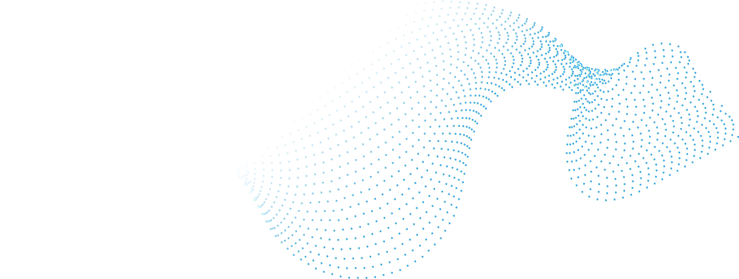

System requirements
Processor: Intel i3 9th gen(Min)
Ram: 4GB DDR4
Internet Connectivity
OS: Windows 7+
Language : Python
Libraries used : nltk, wordnet, pyTorch, openai, pyttsx3, speech_recognition, flask

Slide 6
Related Work
The existing tools provide text annotation tools, such as bookmarking, note taking, or outlining facilities. However, these facilities are often crude. For example, the user often cannot directly go to the position of a bookmark in the original document (through a hyperlink, for example), or integrate bookmarks into existing outlines; thus limiting his access.
NLP techniques used to improve the reading and writing tasks of the visually handicapped include word prediction and homonym checking. Word prediction allows the application to predict the most likely word to be typed given the previous context. The user types a letter and the program offers a list of the most likely words beginning with that letter. If the required word is on the list, it can be quickly selected. If the word is not on the list, typing the next letter will bring up a different choice and so on. Homonym support provides auditory and visual reinforcement of commonly confused like-sounding words. To avoid the confusion between homophones, the program colour codes confusable words and lists possible alternatives with audible definitions and sample sentences.

Slide 7
TIMELINE
Review 0
Review 2
Review 1
Review 3
Basic outline & framework
Fully-functional Protoype
The big Idea
Implementation and Integration

Slide 8
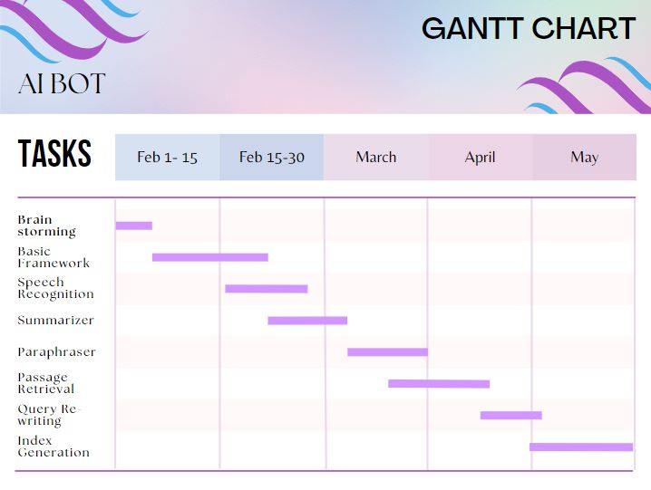
Gantt Chart

Slide 9
References
G. A. Miller. The magical number seven, plus or minus two: Some limits on ourcapacity for processing information. Psychological Review, 63:81–97, 1956.Google Scholar
CSUN’s 20th Annual International Conference “Technology and Persons with Disabilities”, Los Angeles, March 2005.

Slide 10
THANKS!

